Slide 1
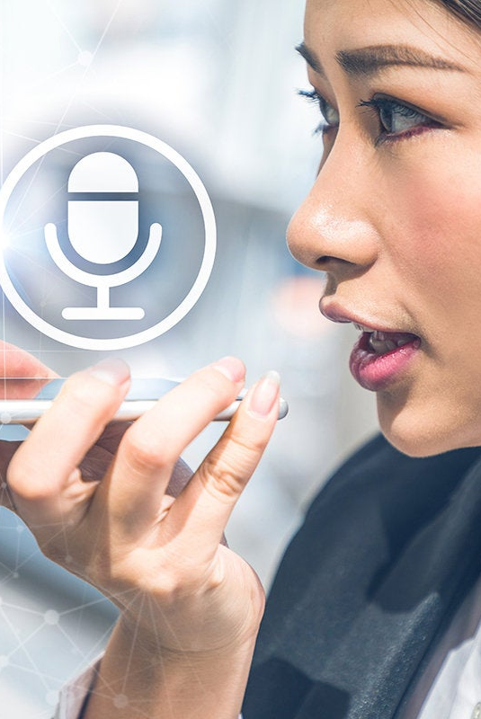

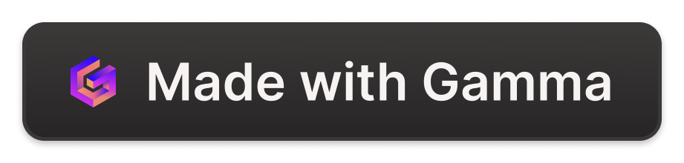
Python based AI voice assistant
This presentation will introduce you to Python-based AI voice assistants, their significance, and applications. We'll dive into the features, development, integration, and potential limitations of building an AI voice assistant from scratch with Python.

Slide 2
Presentation Credits
Presented To
Presented By
Swarsha Kashyap (Assistant Professor)
Akshat Mishra
Ankit Pal
Akshay Singh Senger
Divyam Tiwari

Slide 3

What Are AI Voice Assistants?
1
2. Importance and Applications
AI voice assistants have revolutionized the way we interact with technology, making several daily tasks much more accessible and efficient. They're used to do everything from scheduling appointments to ordering food and even making phone calls!
Definition
AI voice assistants are virtual personal assistants that use voice recognition and natural language processing to execute various tasks as per user commands.

Slide 4
Features of Python-Based AI Voice Assistant
Speech Recognition
Natural Language Task Automation Processing
The AI assistant can accurately understand and recognize human speech. It then translates it into data so that it can be processed and executed.
The assistant can perform various pre-defined tasks upon receiving voice commands, causing your devices and applications to act accordingly.
The AI assistant can analyze and understand natural language so you can communicate with it in the way that you would with another person.

Slide 5
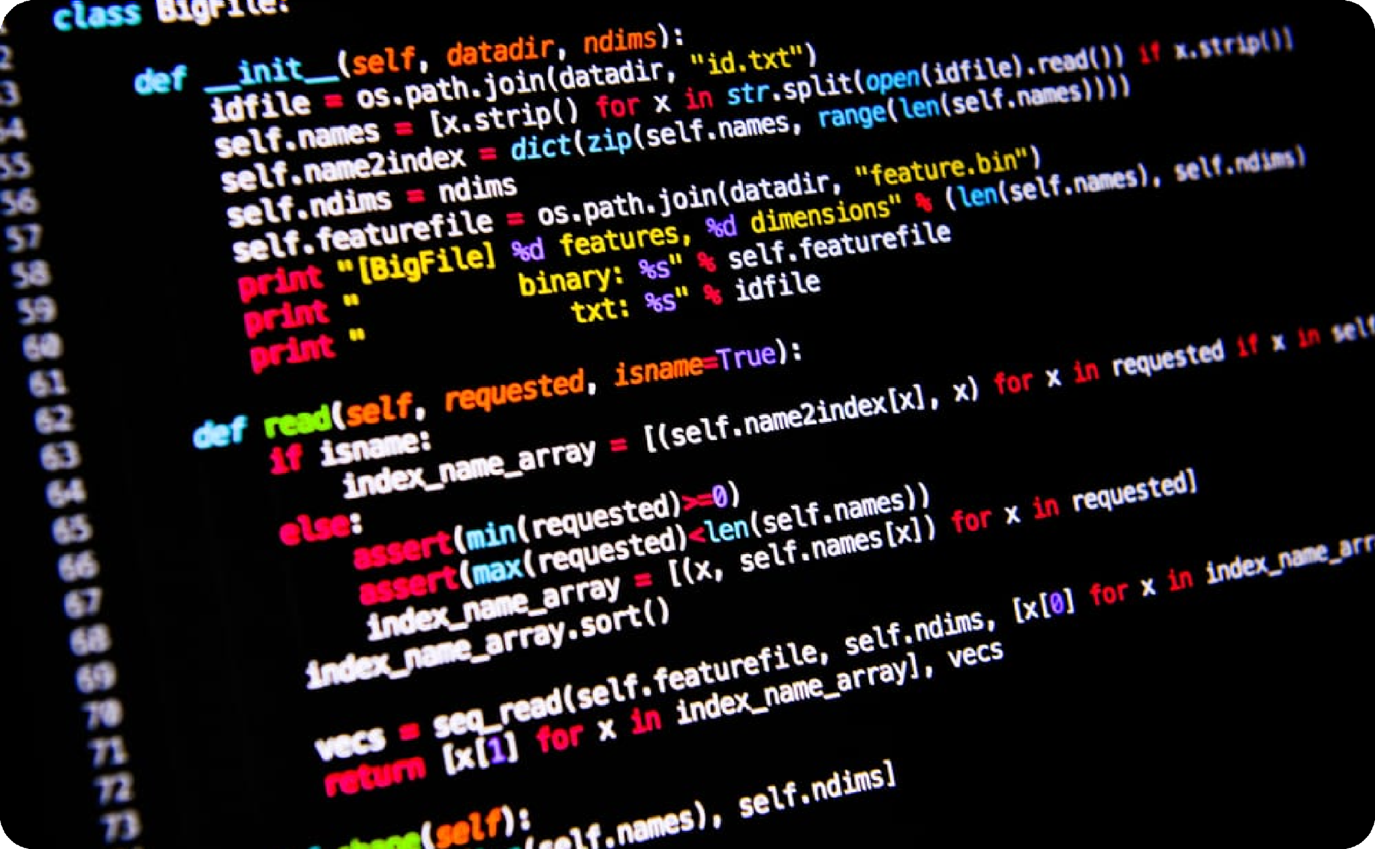
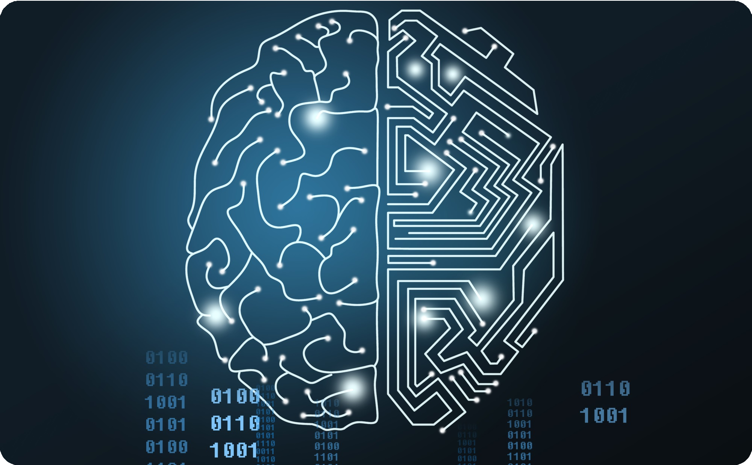
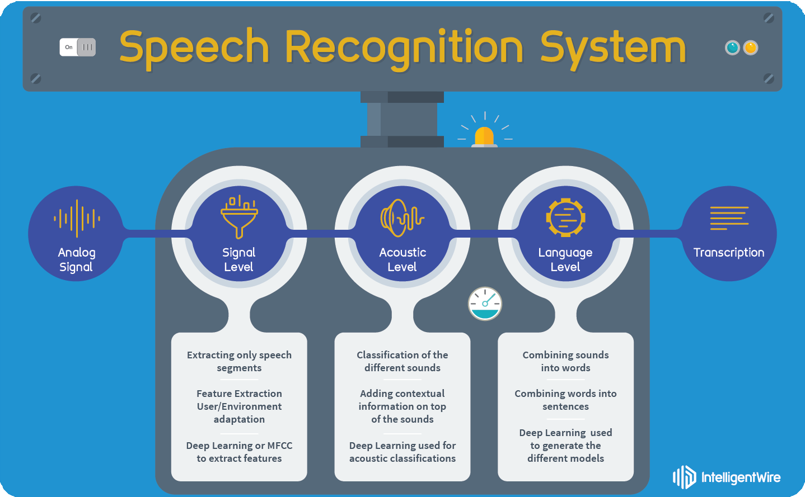
Building a Python-based AI Voice Assistant
Choosing the Right Libraries and Tools
Designing and Training the AI Model
Implementing Voice Commands and Responses
Python offers numerous open- source libraries and tools for building AI voice assistants.
Choosing the right ones can help create a robust and effective AI model.
Designing and training the AI model allows it to respond to user commands elegantly, accurately, and intelligently.
The AI model requires implementing voice commands and responses alongside the targeted features. Perfecting these commands ensures effective communication between user and assistant.

Slide 6
Integration and Deployment of the AI Voice Assistant
Connecting to External APIs and Services
Ensuring Compatibility with Different Devices
Deploying the Assistant to the Cloud or Local Device
The AI voice assistant may require integrations with external APIs and services to perform more complex tasks, such as booking a reservation.
The AI voice assistant should be compatible with various devices, including smart homes and IoT devices.
After ensuring compatibility, the assistant can be deployed to either the cloud or a local device to provide a seamless experience to the user.

Slide 7
Potential Challenges and Limitations
1
Accuracy and Understanding Limitations
The assistant may encounter a few problems with voice recognition and natural language processing, leading to misunderstood commands or errors in communication.
Privacy and Security
Concerns
2
As with any electronic device with access to sensitive information, the AI voice assistant has the potential for privacy and security breaches.
3
Integration with Different Platforms and Technologies
The assistant may encounter compatibility issues with different platforms and technologies.

Slide 8
Future Trends and Possibilities
Advancements in AI voice Integration with Smart Homes and technology IoT devices Technology will continue to progress and In the near future, voice assistants will play an evolve, making voice assistants more intuitive integral role in smart home devices and IoT. and improving their cognitive abilities. Imagine turning off your oven with just a word!
Potential Commercial Applications The ability to perform tasks quickly and efficiently is a significant selling point for businesses who require a significant amount of time-saving processes. Voice assistants will increasingly pick up as a result.

Slide 9
Conclusion
1
Recap of the Benefits and Capabilities of a Python-based AI Voice Assistant
Overall, Python-based AI voice assistants can transform the way we live our daily lives, making tasks faster, more efficient, and convenient.
2
Encouraging Further Exploration and Development in the Field
The development of voice assistants has reached various industries and sectors, increasing their significance. There is a need for further exploration and development of technology to leverage its possibilities better.

Slide 10

Thankyou
On behalf of our team, we would like to express our heartfelt gratitude for your time and attention. We hope you found this presentation informative and engaging. If you have any questions or would like to discuss further, please feel free to reach out to us.

